Slide 1
Keyhole Press
Southminster Presbyterian
November 2022
From the Pastor
Good day to each one of you.
Tradition has tremendous power. “The way we do things” seems in any organization, including the church, to take on a certain sanctity. Breaking out of the patterns of the past is difficult and painful. But often human traditions are built, as is a pearl, to insulate against irritation - to block out anything that attacks our comfort, or constantly pricks our consciences. Or something that demands attention. It was that way in the Judaism of Christ’s day. Tradition had built up great walls insulating God’s people from His Word. Under the guise of religion, thick trappings had been thrown over the clean and the powerful - and demanding - Word.
Jesus’s reaction to criticism based on tradition was quick and to the point. One passage particularly - due to limited space I can’t insert the passage (please read Mark 7:1-8) - which ends in the well-known words, “You are so busy holding on to the traditions of men that you let go of the commandments of God.”
I am not quoting this passage to demean any who may disagree with me and hold a more “traditional” view of church. Neither do I say that Southminster sanctified the way we do things. I do it to point out, to make us aware, that it is easy for anyone to become “so busy holding on to the traditions of men or ladies” that we can “let go of the commandments of God, individually and collectively as a church community”. And if in fact we do this, Lawrence O Richards says, “ it can only be because we have lost confidence in God: lost that complete willingness to abandon ourselves to Christ and His Word”.
The church is to exist as a body of people who are committed to Jesus Christ and to His Word. Christ lives, and His Word is more than powerful enough to break through any tradition and bring us to experience His full reality, individually and in our church communities.
After three months of being at Southminster, being one of you and with you, I am convinced that if ever needed, we are completely willing to abandon ourselves to experience God’s full reality even more than we experience it at present. To God the glory.
Yours in Christ, Jock

Slide 2
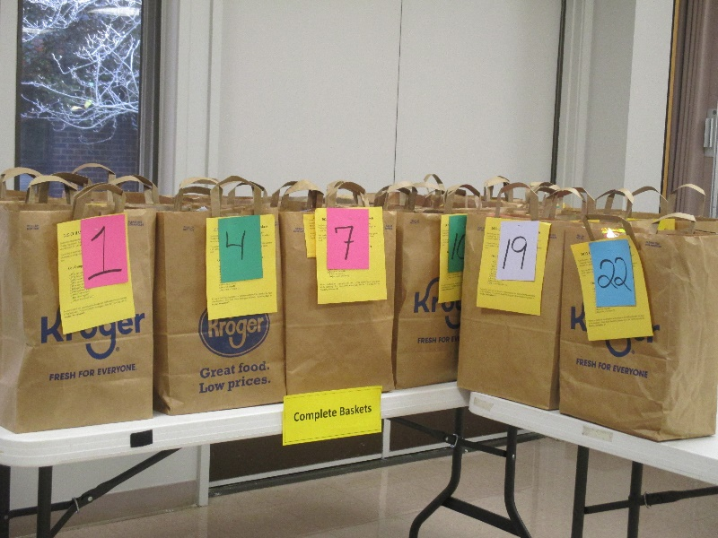
Congregational Life
Page 2
Intergenerational Advent Worship Service
On Sunday, December 4th Southminster will celebrate the approaching Christmas season with a special intergenerational Advent worship service.
The day will kick off at 9:00 AM with a pancake breakfast in the Fellowship Hall hosted by Girl Scout Troop 603. The pancake breakfast is an annual fundraiser for the troop. The suggested donation for breakfast is $5.00 per plate. Rumor has it that Santa will also put in an appearance (stay tuned for details). Following breakfast and Sunday School, we will head into the Sanctuary for our worship service.
Lessons and Carols 2022
The Sanctuary Choir is hard at work preparing an exceptional musical celebration for the Christmas season.
The Servif Lessons and Carols follows a structure which dates back to the late 19th century. It features nine scripture lessons recounting the miraculous story of Jesus’ birth, followed by a carol or song that reflects on the lesson's message. Join us for our Service of Lessons and Carols service on Sunday, December 11th at 11:00 AM, followed by a reception in the Fellowship Hall.
If you would like to be involved in the service, please reach out to Kimberly Ryan at keliseryan@gmail.com.
Church In The World
CCHASM Thanksgiving Baskets
Every year, CCHASM works with area churches to put together non-perishable food items for their Thanksgiving baskets. To help them reach their goal for 2022, Southminster has pledged to contribute 28 baskets. We are proud to report that as of this newsletter printing, we have assembled 22 baskets, meaning we should reach and may even exceed our pledge!
Food may be brought to the church through Sunday, November 6th. You can find the shopping list in your Sunday bulletin and on our website. Be sure to check out our tracking board at the back of the sanctuary to see what items we are short on.
Thank you to everyone who has contributed so generously to the Thanksgiving Baskets this year!

Slide 3
Finance
Page 3
Commitment Sunday
I’ve always been a Presbyterian. My parents, their parents and most of their parents before were also Presbyterians. The common denominator with all of them was they just never talked about money. This certainly included their financial support of their churches. I can still remember my mom asking dad if he had turned in their pledge for the coming year. He always replied, “I’ve taken care of it, Miss Julia.” And he had. As they got older and began to travel more, I began to pay their bills using their check book, while they were away. Their church commitment was one of the checks that I wrote each month. Mom and dad’s devotion to their church has always served as an example to me. With Commitment Sunday coming up in November, I hope all of us recognized the countless blessings that we share. And how much our church is a part of those blessings. So please remember to support our church during Commitment Season. Your financial support is vital to the many ministries that we sponsor and to the overall health of our church itself. On November 20th, let’s all be able to say, “I’ve taken care of it.”
Leadership & Planning
Nominating Committee 2023
Nominations are now being taken for active members to serve on the 2023 Nominating Committee. Any active member may volunteer or submit names of individuals to serve on the committee. The 2022 Nominating Committee will put together a recommended slate for the 2023 Nominating Committee. You may submit names by using the inset in your Sunday bulletin or by sending your nominations to the church. Nominations should be placed in Jennifer Weddle’s mailbox by November 27th.
Facilities
Presbyterian Women
Ruth Circle
November 1st at 2:00 PM
Conference Room
Anna Circle
November 1st at 6:30 PM
Debbie Greenberg’s residence
Martha Circle
November 2nd at 10:00 AM
Conference Room
Inclement Weather Policy
In case of inclement weather on a Sunday morning, the decision to cancel services will be made by the pastor and the facilities chairperson by 7:30 AM.
By 8:00 AM, closing notices will be submitted to local Richmond CBS, NBC, and ABC stations, a notification will be sent to the email list, and a notice will be posted on the church Facebook page. You may also call the church office where the voicemail message will be updated with appropriate information.

Slide 4
Special Announcements
Page 4
Cents-ability Offering
On the fourth Sunday of each month, Southminster collects the Cents-ability Offering (also known as the 5 Cents a Meal Offering). The offering is so named to remind people to collect their spare change throughout the month to help fight hunger in their community.
One of the missions this offering supports is the Southminster Food Closet. With grocery costs steadily rising, the Food Closet has been straining to support our clients. We are so incredibly grateful to everyone who helps us by donating food and making monetary contributions to the Food Fund. Remember that even spare change can help! If you have never taken part in the Cents-ability Offering before, perhaps take the month of November to set aside your change and see how much adds up. On the fourth Sunday, look for the yellow envelopes in the pews to give your offering.
Community Thanksgiving Service
Southminster will be participating in the annual Community Thanksgiving Service at Elkhardt Baptist Church on Tuesday, November 22nd at 6:00 PM. We encourage all Southminster members who are able to join their neighbors in the spirit of thanksgiving and fellowship.
The Thanksgiving Community Offering will be in support of CCHASM and its mission to better the lives of our friends and neighbors.
Rev. O’Connell Out of Office
Rev. Jock O’Connell will be out of the office from November 14th through November 21st while he and his family move house. In the event of a pastoral emergency, he can be reached by cell phone at 804-514-6260, or you may always contact the church office at 804-276-1749.
2022 Poinsettia Dedications
Poinsettia dedications are a wonderful way to remember and honor loved ones during the holiday season. The poinsettias will decorate the Sanctuary on December 11th and 18th.
Order forms will be available in the bulletins beginning in November. You may also order by contacting the church office at office@southpreschurch.org. The poinsettias will cost $11.50 each this year. Checks should be made payable to Southminster. Orders must be received by Monday, November 28th.
Progressive Dinner
The Southminster Progressive Dinner will take place on Saturday, December 10th. Dinner guests will progress from host house to host house, beginning with appetizers at 6:00 PM, followed by dinner at 7:15 PM and dessert at 9:00 PM.
The cost of the dinner is $17.00 per person. RSVP and hosting forms will be available in the Narthex. Brown Pearson is also actively seeking host homes for the dinner. If you are interested in hosting or have questions, please contact Brown at 804-347-8895.

Slide 5
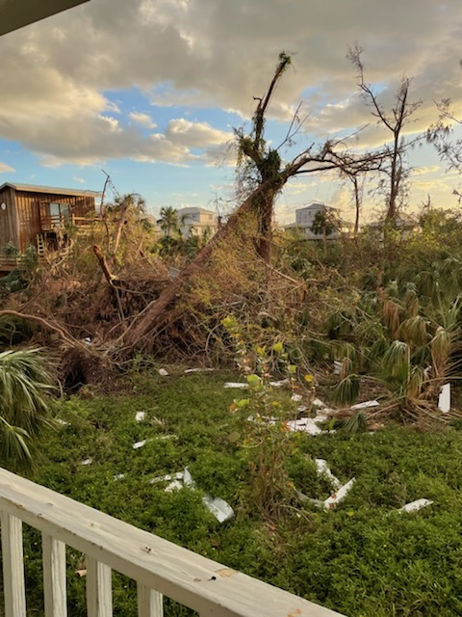
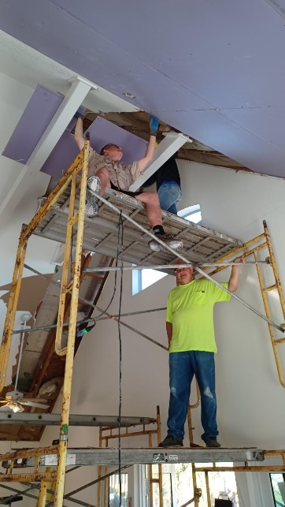
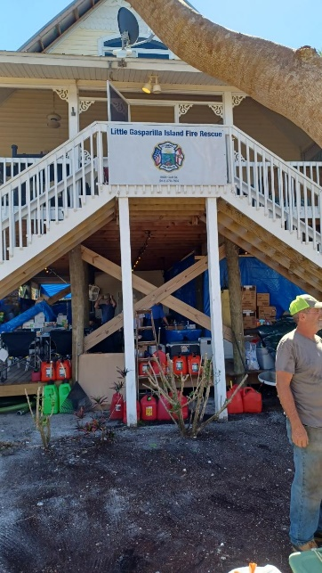
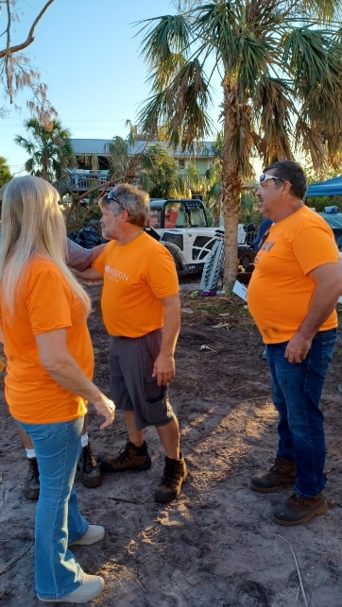
Page 5
Disaster Relief Mission Trip
During the week of October 22nd – 29th several Southminster members traveled to Little Gasparilla, Florida as part of the Presbytery of the James’ Disaster Relief Team to help with cleanup from Hurricane Ian. A second trip is being planned for January. Please reach out to Brown Pearson at 804-347----8895 or cbpearson3@erg-homes.com for more information.
Directory Updates
Ramona Clopton
Chesterfield Heights
901 Madrona Street
Apt. 201
Midlothian, VA 23114
252-216-6599
Southminster Notes
A heartfelt thank you to all of those wonderful folks who worked behind the scenes to make it possible for RISC’s Team Leader meeting to happen at Southminster on September 8th. You all are treasures.
Setting up tables and chairs: Rich Kowalski and Frank Grier.
Microphone and speaker checks: David Huff and Brown Pearson.
And the faithful, caring ladies who put on the Derrenbacker reception and cleared up completely after: Mary Stahl, Ann Wilkins, Betsy Davis, Becky Rowan, and Karen Stafford.
All of you helped pull off our first very busy week of return to “normal” after two and a half years of pandemic.
Jan Belote
Notes will be published as space permits. Some notes will carry over to next month’s newsletter.

Slide 6
Page 6
November Birthdays
November Schedules
Ron Hepp
Rick Schaffer
Patricia Ervin
Robin Lapsley
7 Amanda Bunkholt
Rick Abbott
Donna Medicus, Eric Stahl
Jean Derrenbacker
David Huff
Tammy McDonald
Debbie Dugger, Marcia Shipley,
Caroline Solaimani, Brian Singleton
Jim Dugger
Andrew Swenck
26 Mike Cifelli
Mark Williams
Melanie Miller, Tim Weddle
29 Mel Bookman
If you cannot be present on your scheduled day, please notify your schedule’s organizer.
Communion Team
November 6: Team 2 (Unit/Intinction)
Elder Greeters
6 Eddie Pearson
13 Jennifer Weddle
20 Mary Stahl
27 Robin Lapsley
Facility Stewards
6 Frank Grier
13 Howard Boughton
20 Jerry Davis
27 Jim Hall
Ushers
6 TBD
13 TBD
20 TBD
27 TBD
November Anniversaries
2 Katie & Justin Roland (3)
Jane & Brent Tarter (22)
Andrew & Natira Bookman (9)
5 Andrew & Marit Smith (6)
Gary & Anne Smith (41)
19 David & Lynne Reeser (5)
29 Earl & Donna Medicus (48)
Visitation Team
Riki Stone
Riki Stone
27 Riki Stone
Food Closet
1 Rose Spradin, Shelley Murray
3 Jane Tarter, Margaret Hall
8 Mary Stahl, David Stahl
10 Cheriene McCall, Frank Grier
15 Jane Williams, Melba Jolly
17 Gail DeCosta, Bonnie Kowalski
Shelley Murray, Margaret Hall
24 Thanksgiving
29 Ann Potts, Frank Grier
Have we missed your birthday or anniversary?
Let the church office know: 804-276-1749.

Slide 7
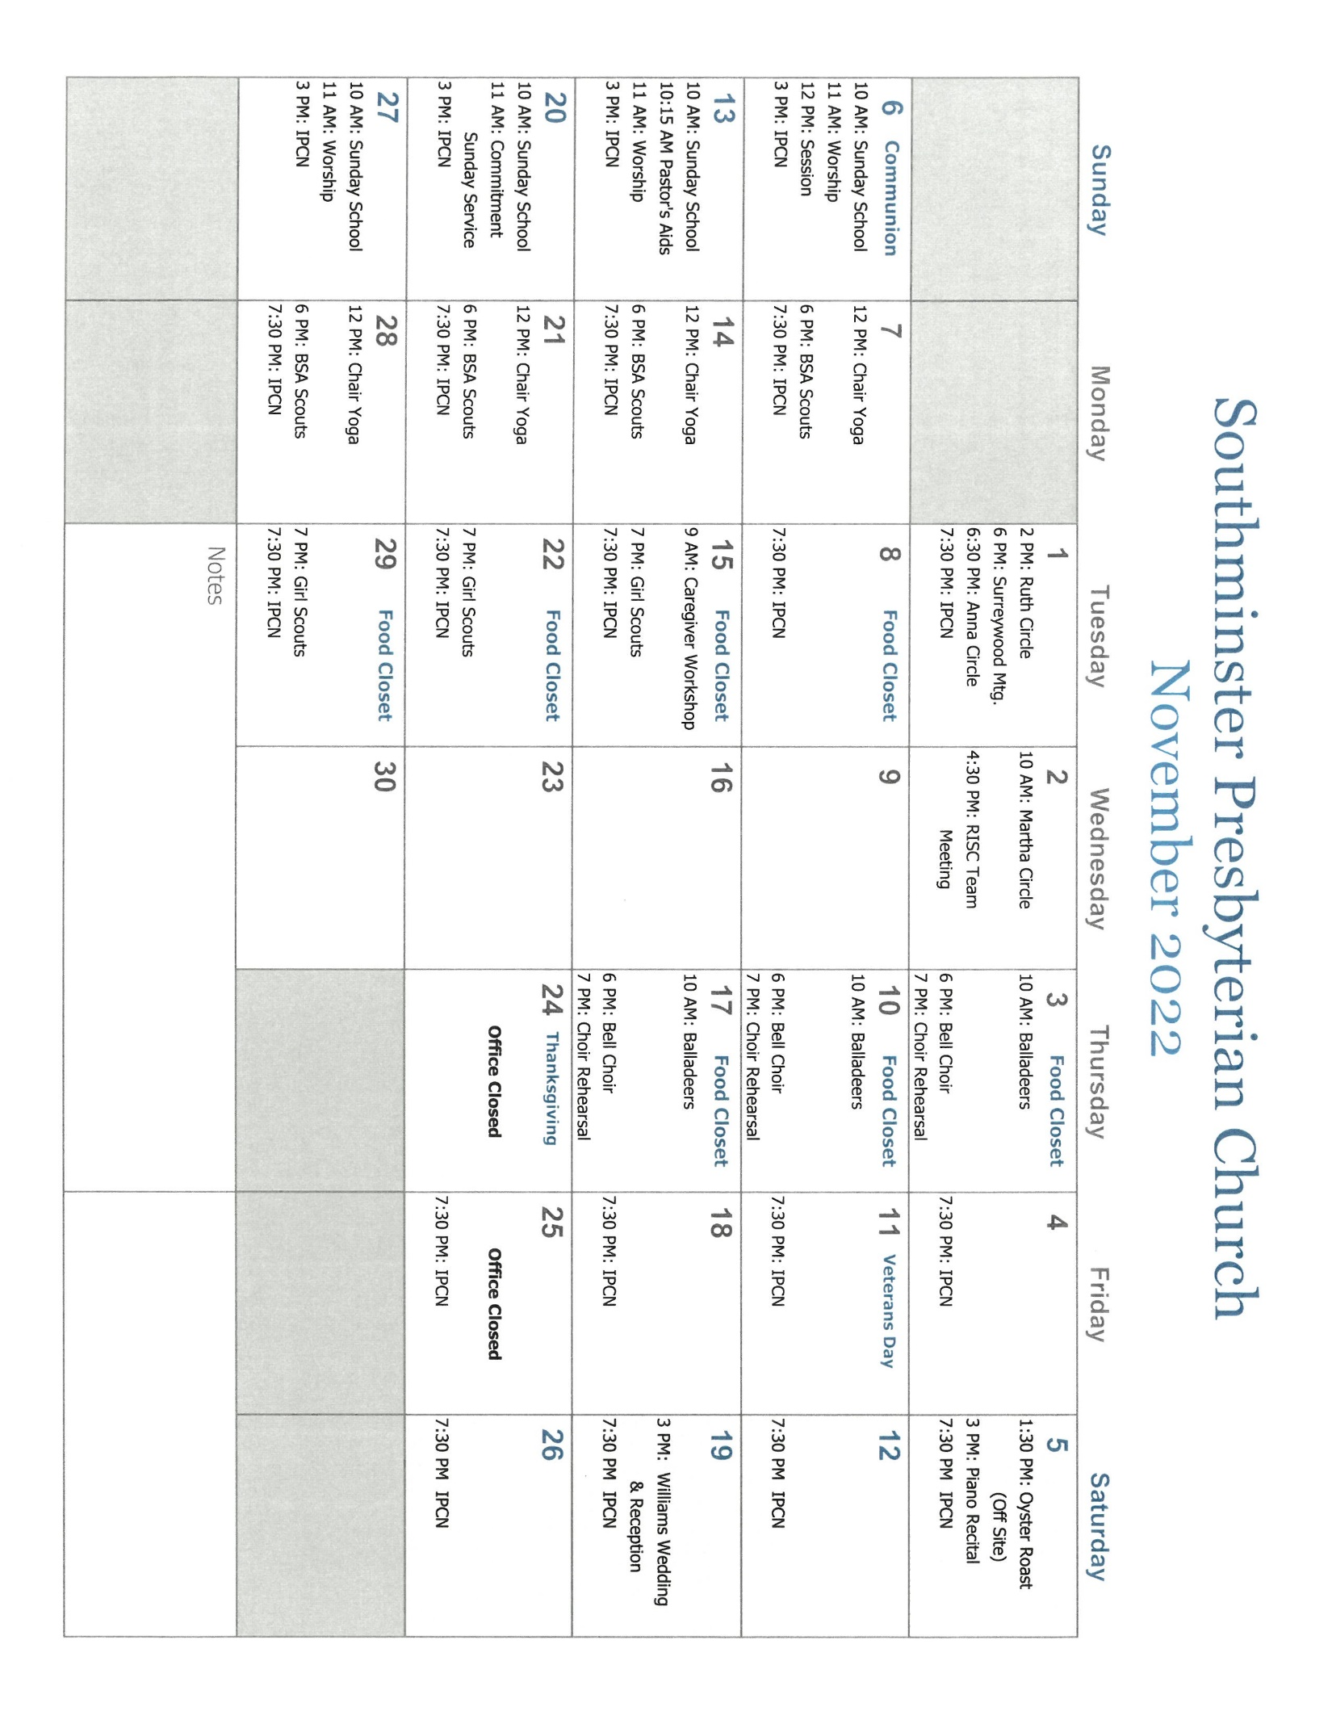
Page 7

Slide 8
SOUTHMINSTER PRESBYTERIAN CHURCH
7500 Hull Street Road
N. Chesterfield, VA 23235-5810
Phone: 804-276-1749
www.southpreschurch.org
office@southpreschurch.org
Return Service Requested
November 2022
Commitment Sunday
November 20, 2022
Join us for service at 11:00 AM
Would you like to receive your newsletter electronically?
Send an email to office@southpreschurch.org with Add Me To Newsletter List in the subject line.

